Slide 1
Lecture 6: Monte Carlo Simulation

Slide 2

Relevant Reading
Sections 15-1 – 15.4
Chapter 16

Slide 3
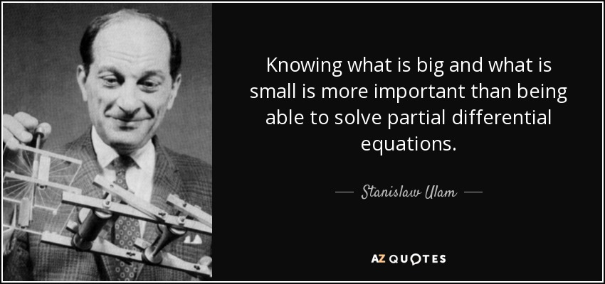
Stanislaw Ulam

Slide 4
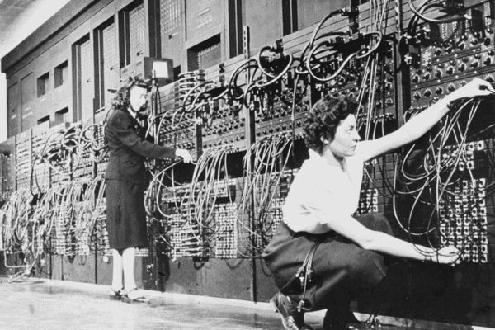
A Little History
Ulam, recovering from an illness, was playing a lot of solitaire
Tried to figure out probability of winning, and failed
Thought about playing lots of hands and counting number of wins, but decided it would take years
Asked Von Neumann if he could build a program to simulate many hands on ENIAC

Slide 5
Monte Carlo Simulation
A method of estimating the value of an unknown quantity using the principles of inferential statistics
Inferential statistics
Population: a set of examples
Sample: a proper subset of a population
Key fact: a random sample tends to exhibit the same properties as the population from which it is drawn
Exactly what we did with random walks

Slide 6
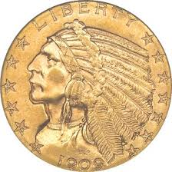
An Example
Given a single coin, estimate fraction of heads you would get if you flipped the coin an infinite number of times
Consider one flip
How confident would you
be about answering 1.0?

Slide 7
Flipping a Coin Twice
Do you think that the next flip will come up heads?

Slide 8
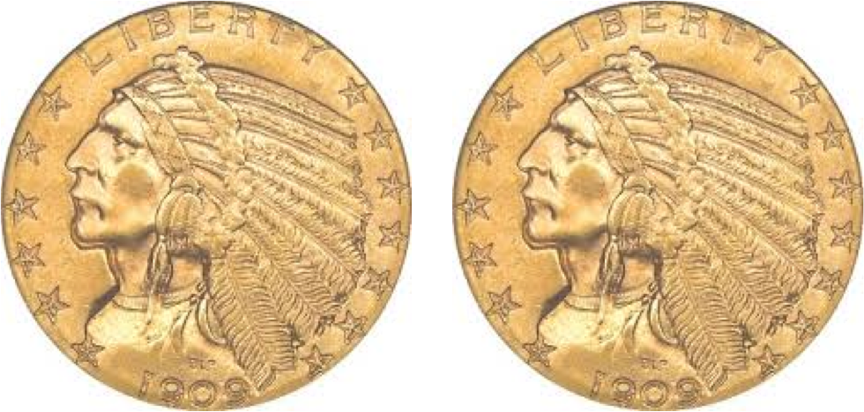
Flipping a Coin 100 Times
Now do you think that the next flip will come up heads?

Slide 9
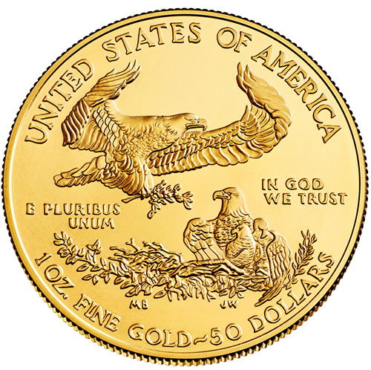
Flipping a Coin 100 Times
Do you think that the probability of the next flip coming up heads is 52/100?
Given the data, it’s your best estimate
©John Guttag
But confidence should be low

Slide 10
Why the Difference in Confidence?
Confidence in our estimate depends upon two things
Size of sample (e.g., 100 versus 2)
Variance of sample (e.g., all heads versus 52 heads)
As the variance grows, we need larger samples to have the same degree of confidence

Slide 11
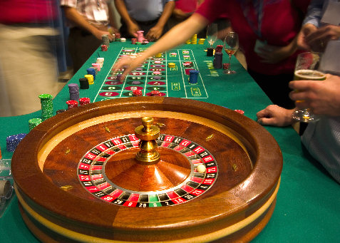
Roulette
No need to simulate, since answers obvious
Allows us to compare simulation results to actual probabilities

Slide 12
Class Definition
class FairRoulette():
def __init__(self):
self.pockets = []
for i in range(1,37):
self.pockets.append(i)
self.ball = None
self.pocketOdds = len(self.pockets) - 1
def spin(self):
self.ball = random.choice(self.pockets)
def betPocket(self, pocket, amt):
if str(pocket) == str(self.ball):
return amt*self.pocketOdds
else: return -amt
def __str__(self):
return 'Fair Roulette'

Slide 13
Monte Carlo Simulation
def playRoulette(game, numSpins, pocket, bet):
totPocket = 0
for i in range(numSpins):
game.spin()
totPocket += game.betPocket(pocket, bet)
if toPrint:
print(numSpins, 'spins of', game)
print('Expected return betting', pocket, '=',\
str(100*totPocket/numSpins) + '%\n')
return (totPocket/numSpins)
game = FairRoulette()
for numSpins in (100, 1000000):
for i in range(3):
playRoulette(game, numSpins, 2, 1, True)

Slide 14
100 and 1M Spins of the Wheel
100 spins of Fair Roulette
Expected return betting 2 = -100.0%
100 spins of Fair Roulette
Expected return betting 2 = 44.0%
100 spins of Fair Roulette
Expected return betting 2 = -28.0%
1000000 spins of Fair Roulette
Expected return betting 2 = -0.046%
1000000 spins of Fair Roulette
Expected return betting 2 = 0.602%
1000000 spins of Fair Roulette
Expected return betting 2 = 0.7964%

Slide 15
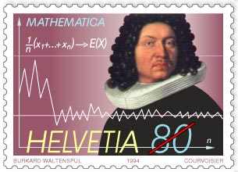
Law of Large Numbers
In repeated independent tests with the same actual probability p of a particular outcome in each test, the chance that the fraction of times that outcome occurs differs from p converges to zero as the number of trials goes to infinity
Does this imply that if deviations from expected behavior occur, these deviations are likely to be evened out by opposite deviations in the future?

Slide 16
Gambler’s Fallacy
“On August 18, 1913, at the casino in Monte Carlo, black came up a record twenty-six times in succession [in roulette]. … [There] was a near-panicky rush to bet on red, beginning about the time black had come up a phenomenal fifteen times.” -- Huff and Geis, How to Take a Chance
Probability of 26 consecutive reds
1/67,108,865
Probability of 26 consecutive reds when previous 25 rolls were red
1/2

Slide 17
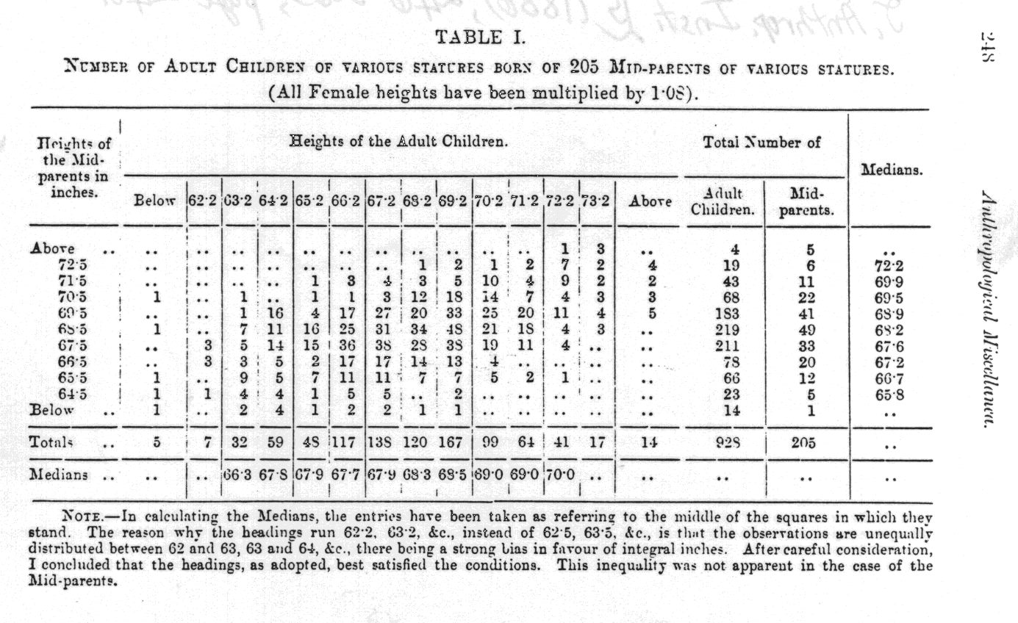
Regression to the Mean
Francis Galton, 1885

Slide 18
Regression to the Mean
Following an extreme random event, the next random event is likely to be less extreme
If you spin a fair roulette wheel 10 times and get 100% reds, that is an extreme event (probability = 1/1024)
It is likely that in the next 10 spins, you will get fewer than 10 reds
But the expected number is only 5
So, if you look at the average of the 20 spins, it will be closer to the expected mean of 50% reds than to the 100% of the first 10 spins

Slide 19
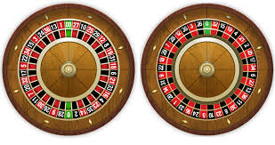
Casinos Not in the Business of Being Fair

Slide 20
Two Subclasses of Roulette
class EuRoulette(FairRoulette):
def __init__(self):
FairRoulette.__init__(self)
self.pockets.append('0')
def __str__(self):
return 'European Roulette'
class AmRoulette(EuRoulette):
def __init__(self):
EuRoulette.__init__(self)
self.pockets.append('00')
def __str__(self):
return 'American Roulette'

Slide 21
Comparing the Games
Simulate 20 trials of 1000 spins each
Exp. return for Fair Roulette = 6.56%
Exp. return for European Roulette = -2.26%
Exp. return for American Roulette = -8.92%
Simulate 20 trials of 10000 spins each
Exp. return for Fair Roulette = -1.234%
Exp. return for European Roulette = -4.168%
Exp. return for American Roulette = -5.752%
Simulate 20 trials of 100000 spins each
Exp. return for Fair Roulette = 0.8144%
Exp. return for European Roulette = -2.6506%
Exp. return for American Roulette = -5.113%
Simulate 20 trials of 1000000 spins each
Exp. return for Fair Roulette = -0.0723%
Exp. return for European Roulette = -2.7329%
Exp. return for American Roulette = -5.212%

Slide 22
Sampling Space of Possible Outcomes
Never possible to guarantee perfect accuracy through sampling
Not to say that an estimate is not precisely correct
Key question:
How many samples do we need to look at before we can have justified confidence on our answer?
Depends upon variability in underlying distribution

Slide 23
Quantifying Variation in Data
Standard deviation simply the square root of the variance
Outliers can have a big effect
Standard deviation should always be considered relative to mean

Slide 24
For Those Who Prefer Code
def getMeanAndStd(X):
mean = sum(X)/float(len(X))
tot = 0.0
for x in X:
tot += (x - mean)**2
std = (tot/len(X))**0.5
return mean, std

Slide 25
Confidence Levels and Intervals
Instead of estimating an unknown parameter by a single value (e.g., the mean of a set of trials), a confidence interval provides a range that is likely to contain the unknown value and a confidence that the unknown value lays within that range
“The return on betting a pocket 10k times in European roulette is -3.3%. The margin of error is +/- 3.5% with a 95% level of confidence.”
What does this mean?
If I were to conduct an infinite number of trials of 10k bets each,
My expected average return would be -3.3%
My return would be between roughly -6.8% and +9.2% 95% of the time

Slide 26
Empirical Rule
Under some assumptions discussed later
~68% of data within one standard deviation of mean
~95% of data within 1.96 standard deviations of mean
~99.7% of data within 3 standard deviations of mean

Slide 27
Applying Empirical Rule
resultDict = {}
games = (FairRoulette, EuRoulette, AmRoulette)
for G in games:
resultDict[G().__str__()] = []
for numSpins in (100, 1000, 10000):
print('\nSimulate betting a pocket for', numTrials,
'trials of', numSpins, 'spins each')
for G in games:
pocketReturns = findPocketReturn(G(), 20,
numSpins, False)
mean, std = getMeanAndStd(pocketReturns)
resultDict[G().__str__()].append((numSpins,
100*mean,
100*std))
print('Exp. return for', G(), '=',
str(round(100*mean, 3))
+ '%,', '+/- ' + str(round(100*1.96*std, 3))
+ '% with 95% confidence')

Slide 28
Results
Simulate betting a pocket for 20 trials of 1000 spins each
Exp. return for Fair Roulette = 3.68%, +/- 27.189% with 95% confidence
Exp. return for European Roulette = -5.5%, +/- 35.042% with 95% confidence
Exp. return for American Roulette = -4.24%, +/- 26.494% with 95% confidence
Simulate betting a pocket for 20 trials of 100000 spins each
Exp. return for Fair Roulette = 0.125%, +/- 3.999% with 95% confidence
Exp. return for European Roulette = -3.313%, +/- 3.515% with 95% confidence
Exp. return for American Roulette = -5.594%, +/- 4.287% with 95% confidence
Simulate betting a pocket for 20 trials of 1000000 spins each
Exp. return for Fair Roulette = 0.012%, +/- 0.846% with 95% confidence
Exp. return for European Roulette = -2.679%, +/- 0.948% with 95% confidence
Exp. return for American Roulette = -5.176%, +/- 1.214% with 95% confidence

Slide 29
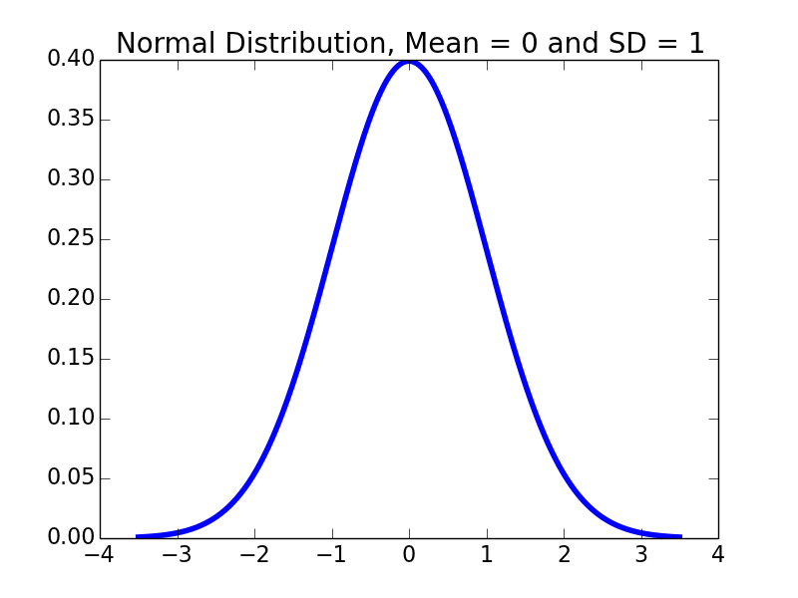
Assumptions Underlying Empirical Rule
The mean estimation error is zero
The distribution of the errors in the estimates is normal

Slide 30
Defining Distributions
Use a probability distribution
Captures notion of relative frequency with which a random variable takes on certain values
Discrete random variables drawn from finite set of values
Continuous random variables drawn from reals between two numbers (i.e., infinite set of values)
For discrete variable, simply list the probability of each value, must add up to 1
Continuous case trickier, can’t enumerate probability for each of an infinite set of values

Slide 31
PDF’s
Distributions defined by probability density functions (PDFs)
Probability of a random variable lying between two values
Defines a curve where the values on the x-axis lie between minimum and maximum value of the variable
Area under curve between two points, is probability of example falling within that range

Slide 32
Normal Distributions
~68% of data within one standard deviation of mean
~95% of data within 1.96 standard deviations of mean
~99.7% of data within 3 standard deviations of mean

Slide 33
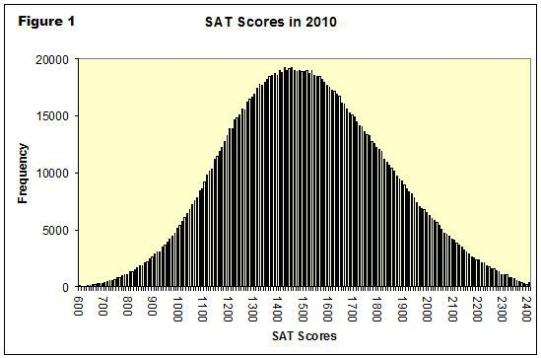
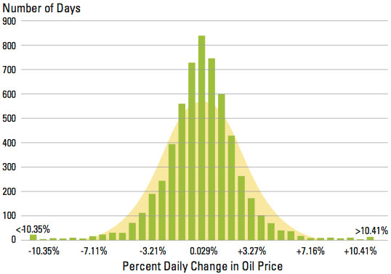
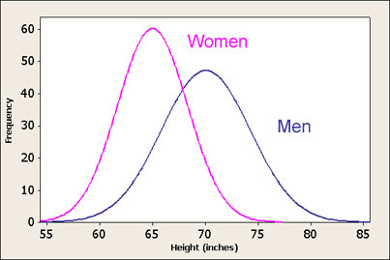
Everybody Likes Normal Distributions
Occur a lot!
Nice mathematical properties

Slide 34
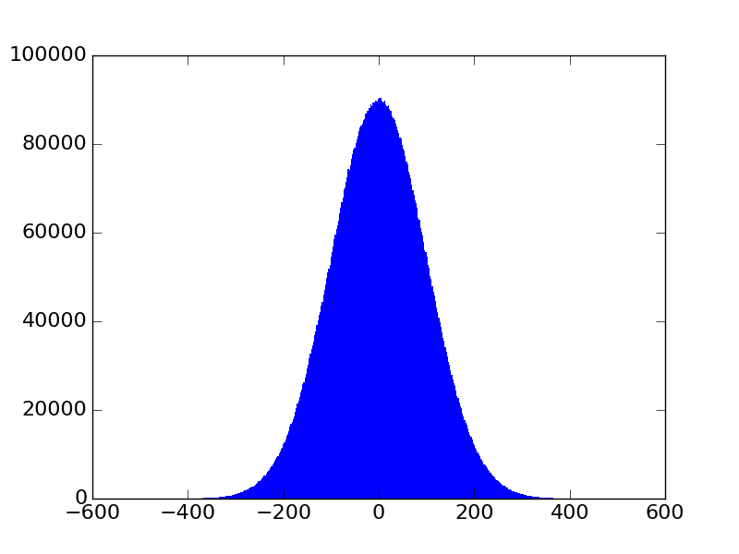
Generating Normal Distributions
dist = []
for i in range(10000000):
dist.append(random.gauss(0, 100))
pylab.hist(dist, bins = 500, edgecolor = 'None')
Discrete
Approximation

Slide 35
Checking Empirical Rule
import scipy.integrate
def gaussian(x, mu, sigma):
factor1 = (1.0/(sigma*((2*pylab.pi)**0.5)))
factor2 = pylab.e**-(((x-mu)**2)/(2*sigma**2))
return factor1*factor2
def checkEmpirical(numTrials):
for t in range(numTrials):
mu = random.randint(-10, 10)
sigma = random.randint(1, 10)
print('For mu =', mu, 'and sigma =', sigma)
for numStd in (1, 1.96, 3):
area = scipy.integrate.quad(gaussian,
mu-numStd*sigma,
mu+numStd*sigma,
(mu, sigma))[0]
print(’ Fraction within', numStd, 'std =', round(area, 4))

Slide 36
A Digression
SciPy library contains my useful mathematical functions used by scientists and engineers
scipy.integrate.quad has up to four arguments
a function or method to be integrated
a number representing the lower limit of the integration,
a number representing the upper limit of the integration, and
an optional tuple supplying values for all arguments, except the first, of the function to be integrated
scipy.integrate.quad returns a tuple
Approximation to result
Estimate of absolute error

Slide 37
Checking Empirical Rule
import scipy.integrate
def gaussian(x, mu, sigma):
factor1 = (1.0/(sigma*((2*pylab.pi)**0.5)))
factor2 = pylab.e**-(((x-mu)**2)/(2*sigma**2))
return factor1*factor2
def checkEmpirical(numTrials):
for t in range(numTrials):
mu = random.randint(-10, 10)
sigma = random.randint(1, 10)
print('For mu =', mu, 'and sigma =', sigma)
for numStd in (1, 1.96, 3):
area = scipy.integrate.quad(gaussian,
mu-numStd*sigma,
mu+numStd*sigma,
(mu, sigma))[0]
print(’ Fraction within', numStd, 'std =', round(area, 4))
checkEmpirical(3)

Slide 38
Results
For mu = 9 and sigma = 6
Fraction within 1 std = 0.6827
Fraction within 1.96 std = 0.95
Fraction within 3 std = 0.9973
For mu = -6 and sigma = 5
Fraction within 1 std = 0.6827
Fraction within 1.96 std = 0.95
Fraction within 3 std = 0.9973
For mu = 2 and sigma = 6
Fraction within 1 std = 0.6827
Fraction within 1.96 std = 0.95
Fraction within 3 std = 0.9973

Slide 39

But Not All Distribution Are Normal
Empirical works for normal distributions
But are the outcomes of spins of a roulette wheel normally distributed?
No, they are uniformly distributed
Each outcome is equally probable
So, why does the empirical rule work here?

